Slide 1
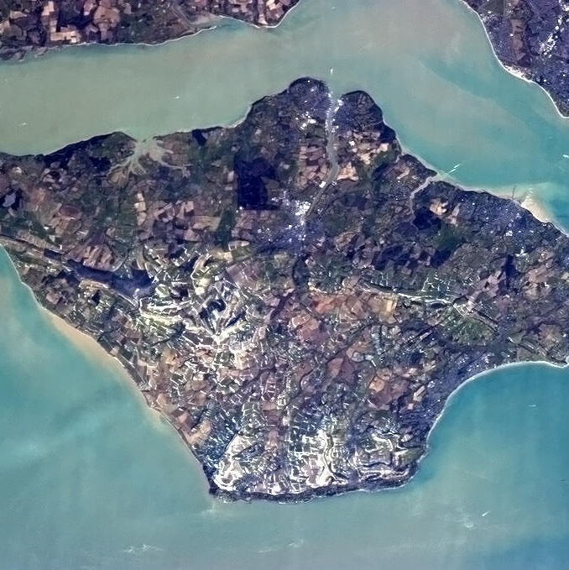
Race to the Isle of Wight

Slide 2
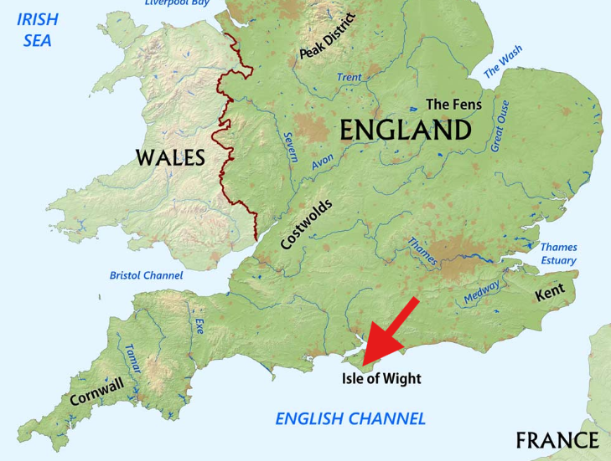

Slide 3
Rules of the race
You will be starting from Farnham and travelling first to a day one location on the mainland. On Day 2 you may leave from your accommodation at 08:00AM to catch a ferry to the island.
You will be able to travel by bus, train and ferry. Taxies can be used as a last resort if it is essential due to safety.
You have a budget of £250 to cover all food, accommodation and travel.

Slide 4
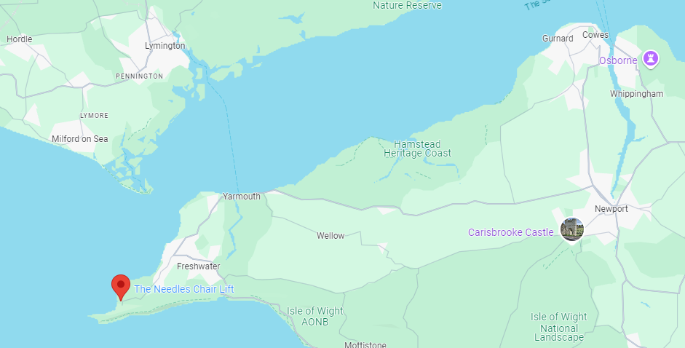
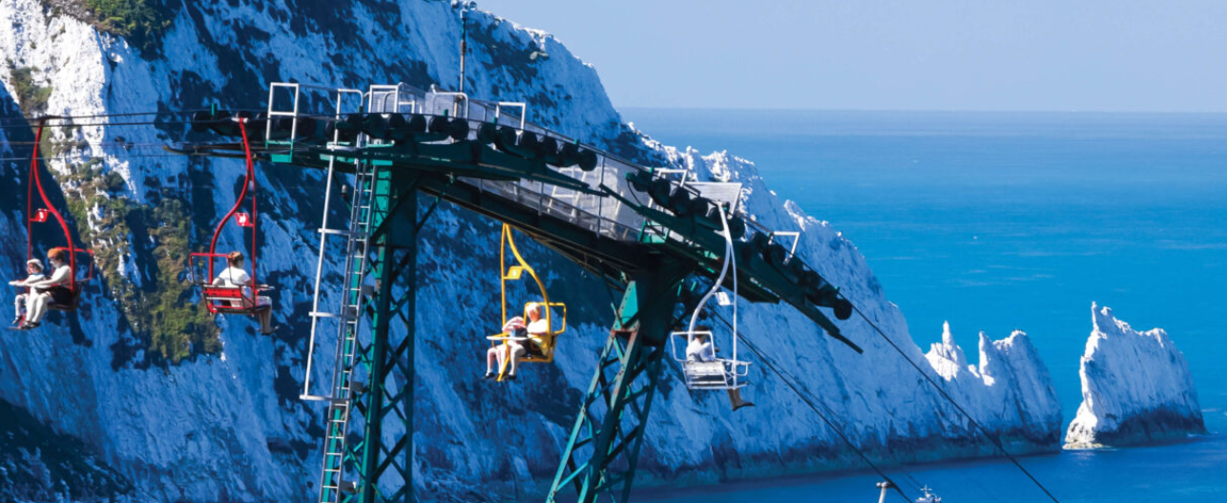
Final location
The Needles Chair Lift lower station

Slide 5
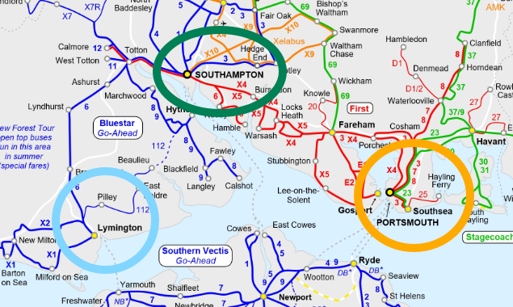
Day one route options
Route 1
Portsmouth
Route 2
Southampton
Route 3
Lymington

Slide 6
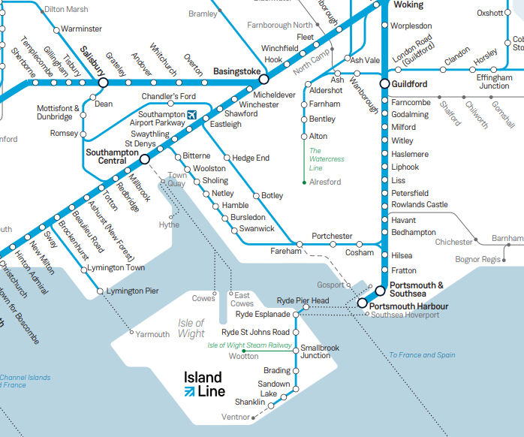
Travel routes

Slide 7
Route 1 - Farnham > Portsmouth
Pros:
Fastest route on day 1: 1 hour and 49 minutes
Portsmouth has a variety of ferry options to the Isle of Wight, with some of the fastest crossings available.
Portsmouth is a vibrant city with plenty to see and do, including the historic Spinnaker Tower, the Charles Dickens Birthplace Museum, and the Historic Dockyard.
Portsmouth has a wide range of accommodation options, from budget-friendly hostels to luxury hotels. There are also many restaurants, cafes, and pubs to choose from.
Cons:
Can be crowded, especially during peak season
Ferry time to the Isle of Wight 45 minutes but furthest from the final destination.

Slide 8
Route 2 - Farnham > Southampton
Pros:
Second-fastest route on day 1: 1 hour and 34 minutes
Southampton has a variety of ferry options to the Isle of Wight, with some of the most frequent crossings available.
Southampton is a major port city with a rich history, and is home to many attractions, such as the Southampton Maritime Museum, the Mayflower Theatre, and the SeaCity Museum.
Cons:
Can be crowded, especially during peak season
Ferry time to the Isle of Wight 60 minutes and second closest to the final destination.
Southampton has a wide range of accommodation options, from budget-friendly hostels to luxury hotels. There are also many restaurants, cafes, and pubs to choose from.

Slide 9
Route 3 - Farnham > Lymington
Pros:
Most scenic route
Lymington is a charming market town with a historic harbour and a variety of shops and restaurants.
Ferry crossings from Lymington to the Isle of Wight are often less crowded than those from Portsmouth or Southampton.
Cons:
Longest route: 1 hour and 57 minute.
Ferry time to the Isle of Wight 40 minutes and closest to the final destination.
Lymington has a range of accommodation options, from mid-range to luxury hotels. There are also many restaurants, cafes, and pubs to choose from.
Accommodation is expensive and more limited.
Fewer ferry options from Lymington to the Isle of Wight compared to Portsmouth or Southampton.

Slide 10
Route summarises
Route 1 | Route 2 | Route 3
Fastest route on Day 1 Fastest crossings Wide range of accommodation Can be crowded, especially during peak season Furthest from final destination on Day 2 | Second-fastest route on Day 1 Most frequent ferry crossings Wide range of accommodation and dining options Second closest to final destination on Day 2 | Most scenic route Longest route on Day 1. Accommodation is most expensive and more limited. Less frequent ferry crossings. Most expensive ferry crossing. Closest to final destination on Day 2

Slide 11
You have 20 minutes to decide and plan your route.
Good luck and we will see you at the Needles.

